Slide 1
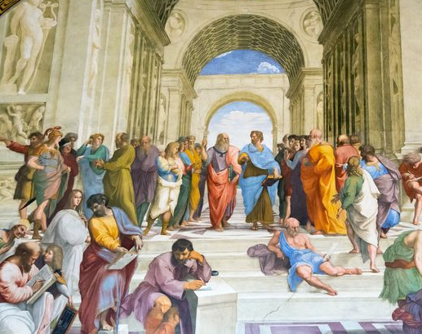
MIT Concourse
Integrated Studies in the Humanities and Sciences

Slide 2
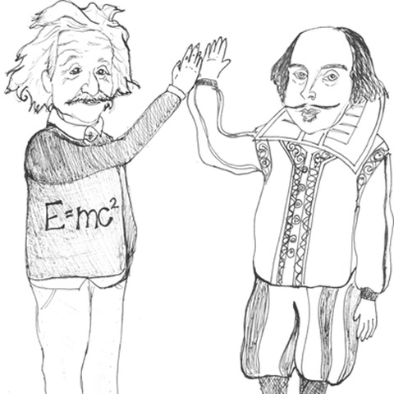
What is Concourse?
First-year learning community of 50 students and 6 dedicated faculty
Rigorous liberal education in conversation with a world class STEM education
Exploration of essential questions of human existence that cultivates independent thinkers and responsible leaders.

Slide 3
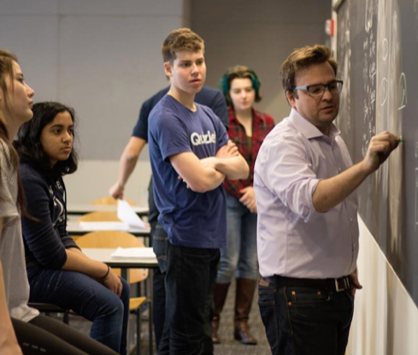
The first-year experience
Weekly Friday lunch seminar where all students and faculty discuss readings and topics that span the disciplines
Humanities classes that investigate the requirements of human flourishing
Technical GIRs that are alive to the human concerns confronting science and technology

Slide 4
Concourse Classes:
All Concourse students take the Friday lunch seminar and CC.110 or CC.115.
Science and Math Courses Fall | HASS (humanities, arts, and social sciences) Courses Fall
5.111 General Chemistry *GIR 8.01 Physics Mechanics *GIR 18.02 Multivariable Calculus *GIR Spring 18.03 Differential Equations 5.12 Organic Chemistry I 8.02 Physics E&M *GIR | CC.110 Becoming Human: Ancient Greek Perspectives on the Good Life CC.115 Defending Poetry: Writing about Big Questions (CI-HW) Spring CC.111 Modern Conceptions of Freedom CC.116 How To Rule The World: Politics, Justice, and Leadership CC.117 Humane Warfare CC.120 Making Books in the Renaissance and Today 21H.134 Medieval Economic History in Comparative Perspective

Slide 5
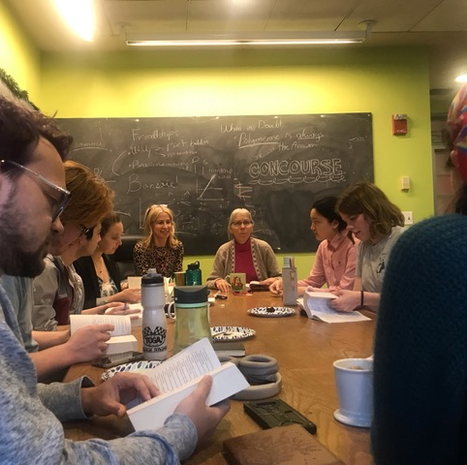
Upper-class offerings
Continuing Conversations seminar
Advanced courses
TA opportunities and training
Associate advising

Slide 6
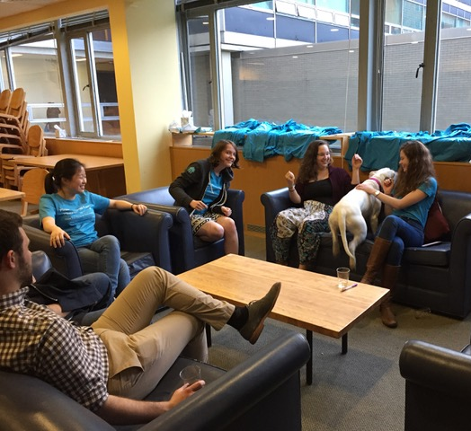
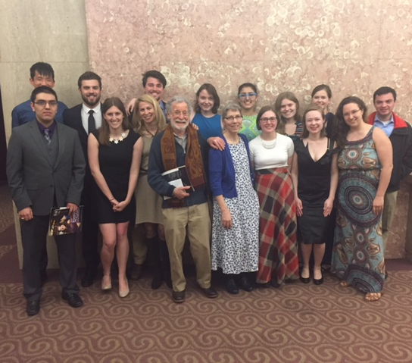
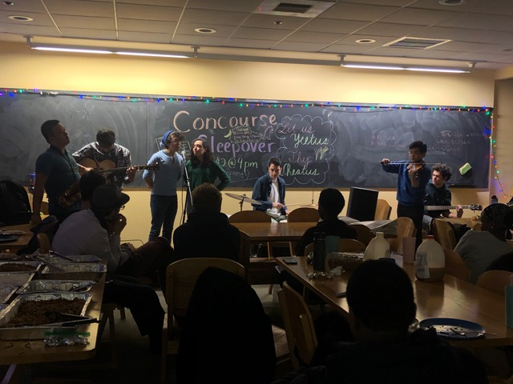
Community and cultural activities
Dedicated spaces
Ongoing small seminars (e.g., theater, current events, political economy)
Reading groups
Outings (e.g., concerts, opera, theater)
Remedial movie nights

Slide 7
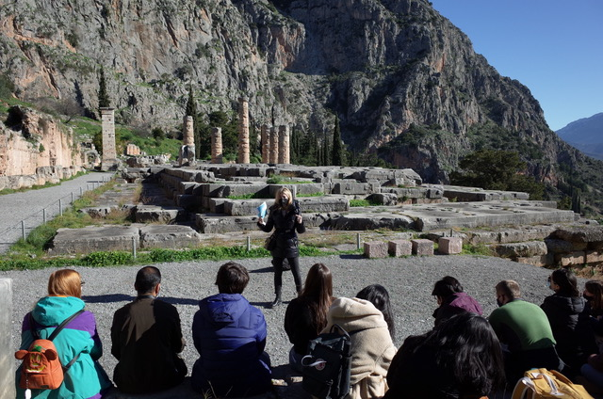
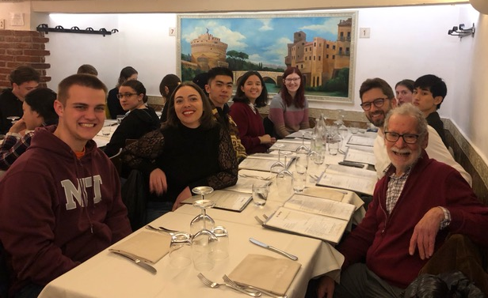
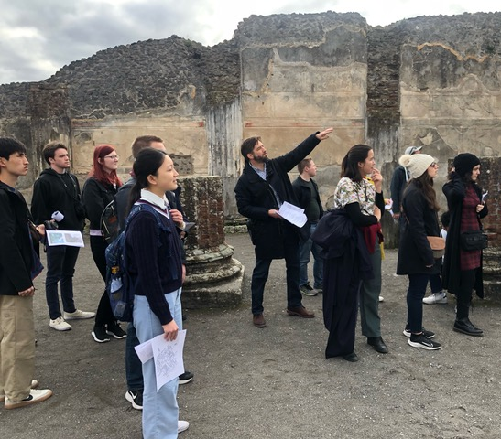
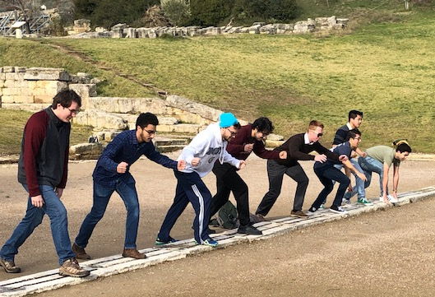
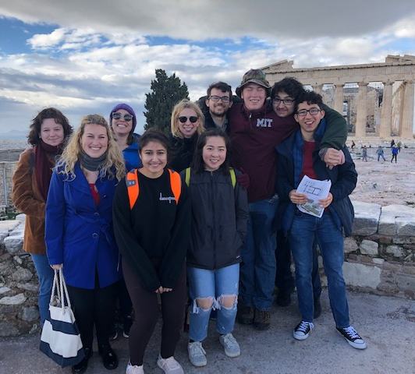
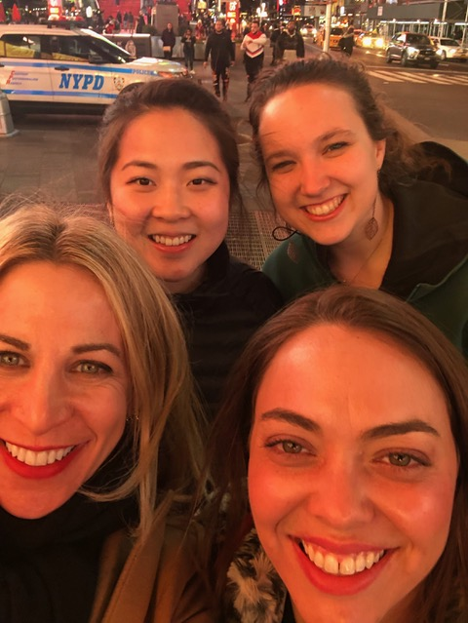
IAP and Spring break trips to Greece, Italy, and NYC

Slide 8
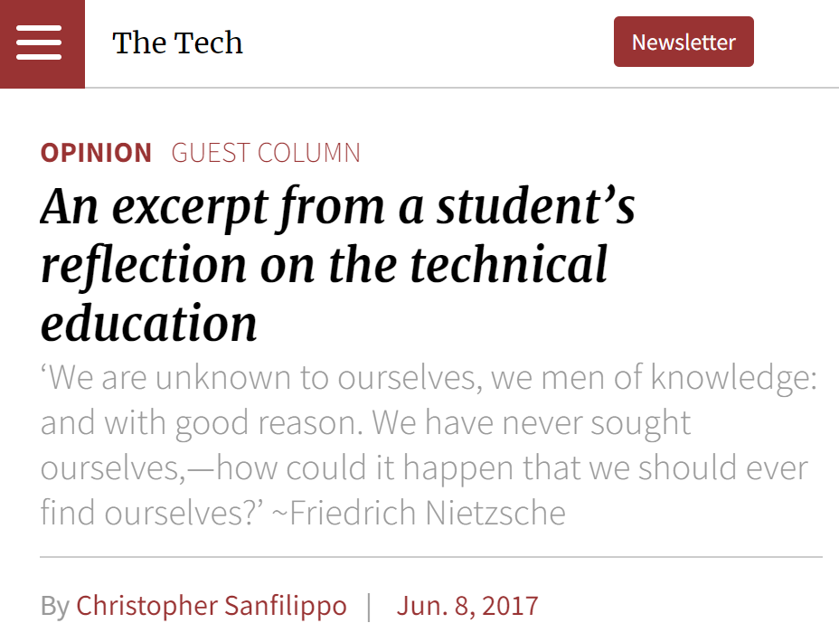
Animating principles
Education
Controversial questions
Open debate
Broadened horizons

Slide 9
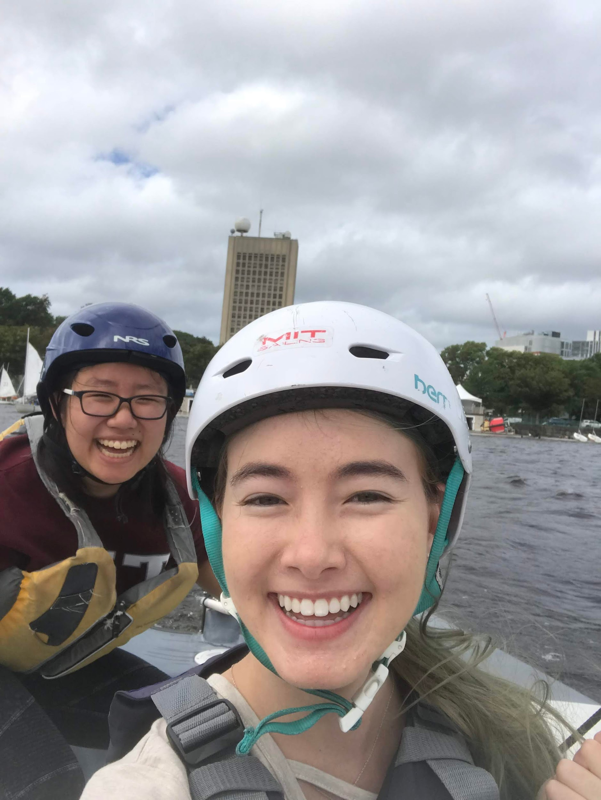
Student Testimonials
Joining Concourse was definitely the best decision I made my first year! I made some of my closest friends while struggling through orgo psets, and I’m so thankful for this community that lets us express our love for the humanities and sponsors any random study break ideas we have.
- Kathryn Tso, 2022 (Materials Science & Engineering and History)
One of the best decisions I made freshman year was joining Concourse! I was able to make amazing friends who wanted to have meaningful conversations about the world with me, which is sometimes difficult to find otherwise at a tech school. Also, Concourse has amazing food and wonderful professors, and is an overall great community to be a part of!
- Alisa Hathaway, 2022 (EECS and Brain & Cognitive Science)

Slide 10
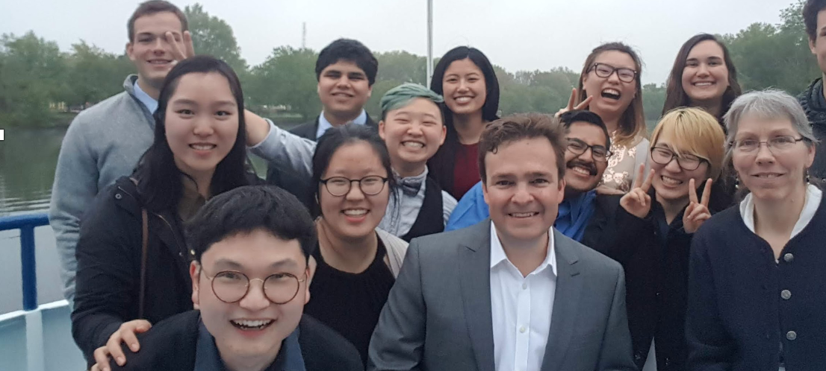
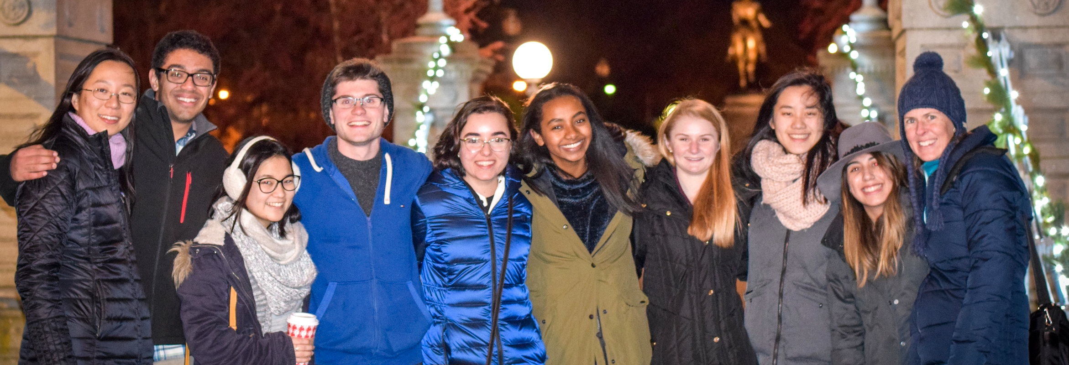
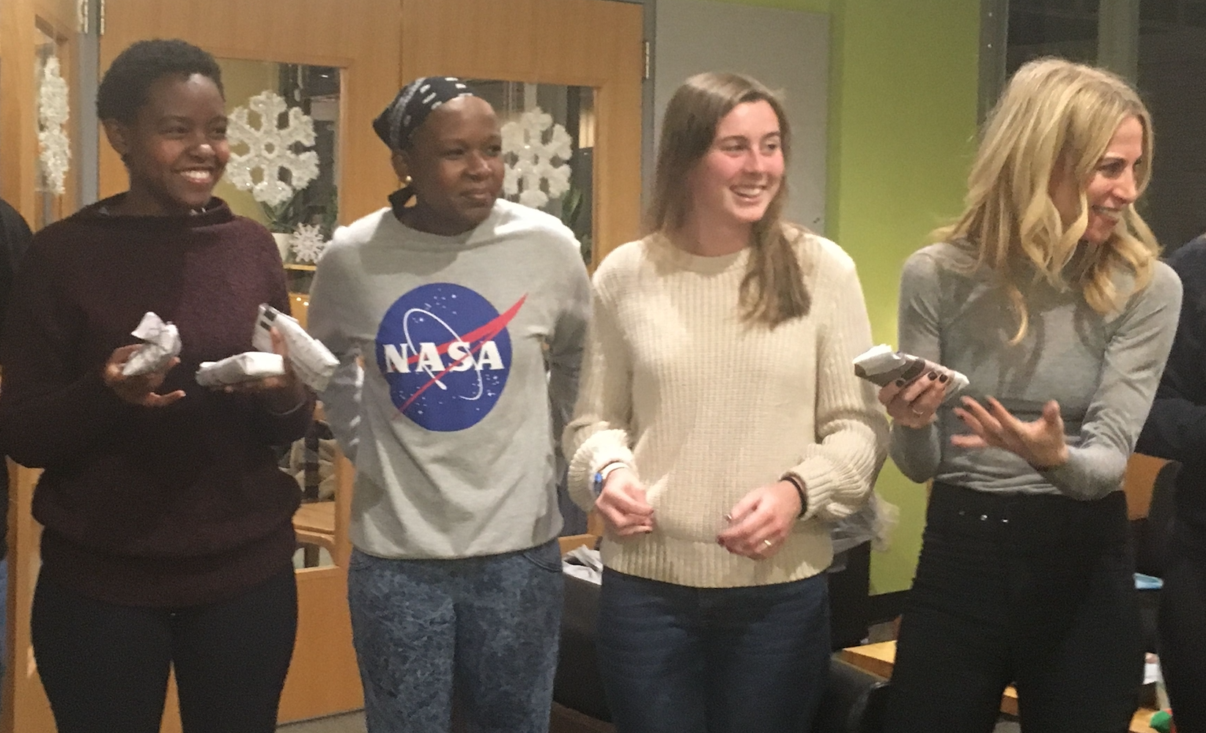
Staff and Faculty Testimonials
Concourse is the place at MIT where you can let your proverbial ‘love-the-humanities' hair down. Talking about interesting and challenging ideas is what we are all about, especially if it is over great food.
- Professor Anne McCants, Director of Concourse & MacVicar Faculty Fellow
I love that Concourse feels like a small liberal arts college within MIT.
-Dr. Beth Taylor, Chemistry
What I love about Concourse is the people it convenes. They take ideas seriously—which makes a lively lounge!—and they’re seriously good at working together.
Professor Erica Zimmer, Making Books in the Renaissance & Today
Our open and curious Concourse students make rich, far-reaching, provocative, and lively conversation the norm around here! There’s no better place on campus for intellectual stimulation. -Professor Linda Rabieh, Political Theory

Slide 11
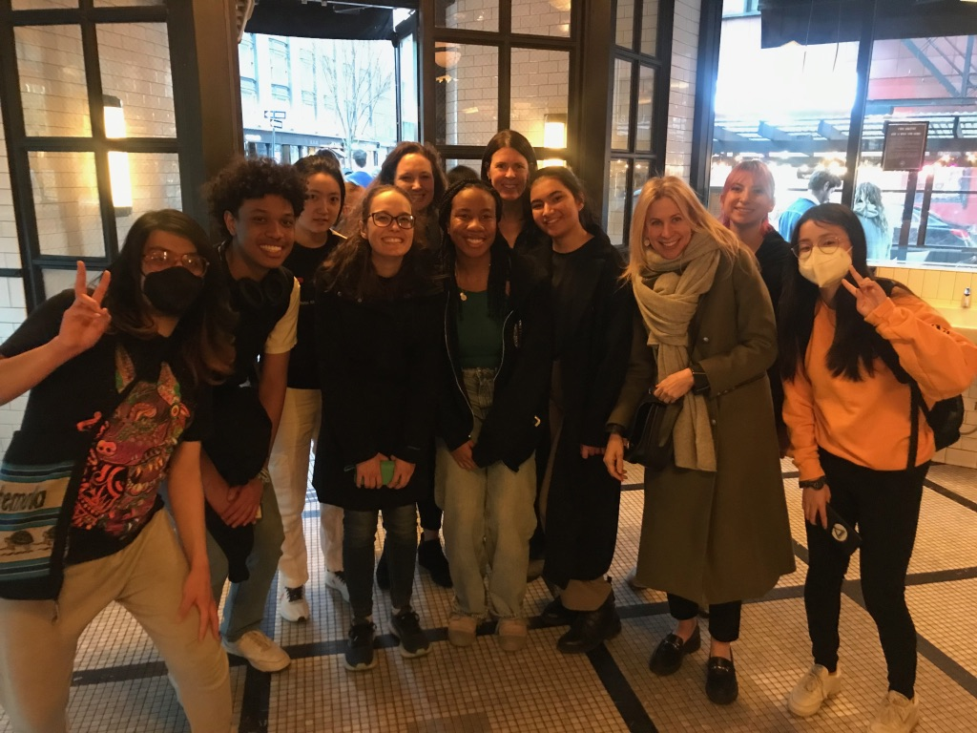
How can I join Concourse?
Access the MIT advising application May 23. Applications due June 13.
Find The Learning Communities link and rank Concourse as your first choice
Questions?
Contact Sasha Rickard
rickard@mit.edu

